Slide 1

Data Management Using Microsoft SQL Server
SQL
Server
2012
Session: 1
Introduction to the Web
Session: 2
E-R Model and Normalization

Slide 2

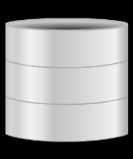

SQL
Server
2012
SQL
Server
2012
Define and describe data modeling
Identify and describe the components of the E-R model
Identify the relationships that can be formed between entities
Explain E-R diagrams and their uses
Describe an E-R diagram, the symbols used for drawing, and
show the various relationships
Describe the various Normal Forms
Outline the uses of different Relational Operators
2

Slide 3

SQL
Server
2012
SQL
Server
2012
A data model is a group of conceptual tools that describes data, its relationships, and semantics.
It also consists of the consistency constraints that the data adheres to.
The Entity-Relationship, Relational, Network, and Hierarchical models are
examples of data models.
The development of every database begins with the basic step of analyzing its data in order to determine the data model that would best represent it.
Once this step is completed, the data model is applied to the data.
3

Slide 4



SQL
Server
2012
SQL
Server
2012
The process of applying an appropriate data model to the data, in order to organize and structure it, is called data modeling.
Data modeling can be broken down into three broad steps:
Conceptual Data Modeling
The data modeler identifies the highest level of relationships in the data.
Logical Data Modeling
The data modeler describes the data and its relationships in detail.
The data modeler creates a logical model of the database.
Physical Data Modeling
The data modeler specifies how the logical model is to be
realized physically.
4

Slide 5

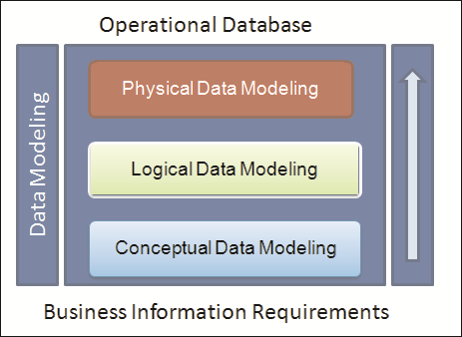
SQL
Server
2012
SQL
Server
2012
Following figure exhibits the various steps involved in data modeling.
Data models can be classified into three different groups:
Object-based logical models
Physical models
Record-based logical models
5

Slide 6
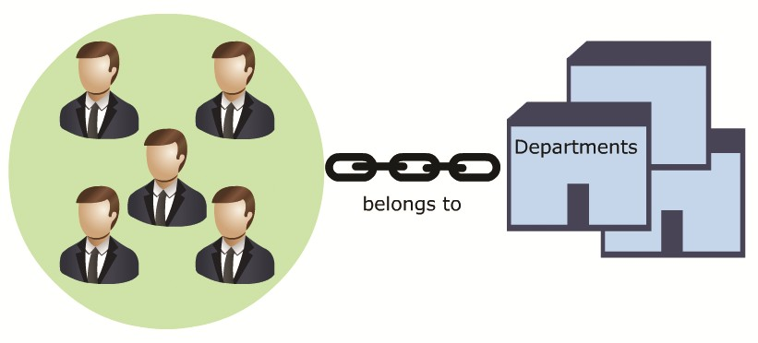
SQL
Server
2012
SQL
Server
2012
The Entity-Relationship (E-R) model belongs to the first classification.
For example, in an organization, both employee and department are real world objects. An employee belongs to a department.
6

Slide 7
SQL
Server
2012
SQL
Server
2012
An E-R model consists of five basic components as follows:
An entity is a real world object that exists physically and is distinguishable from other
objects.
For example, employee, department, vehicle, and account.
Entity
Relationship
A relationship is an association or bond that exists between one or more entities.
For example, belongs to, owns, works for, saves in, and so on.
Attributes are features that an entity has. Attributes help distinguish every entity
from another.
For example, the attributes of a student would be roll_number, name, and so on.
Attributes
An entity set is the collection of similar entities.
For example, the employees of an organization collectively form an entity set called
employee entity set.
Entity Set
A collection of similar relationships between two or more entity sets is called a relationship set.
For example, the set of all 'work in' relations that exists between the employees and the department is called the 'work in' relationship set.
Relationship Set
7

Slide 8
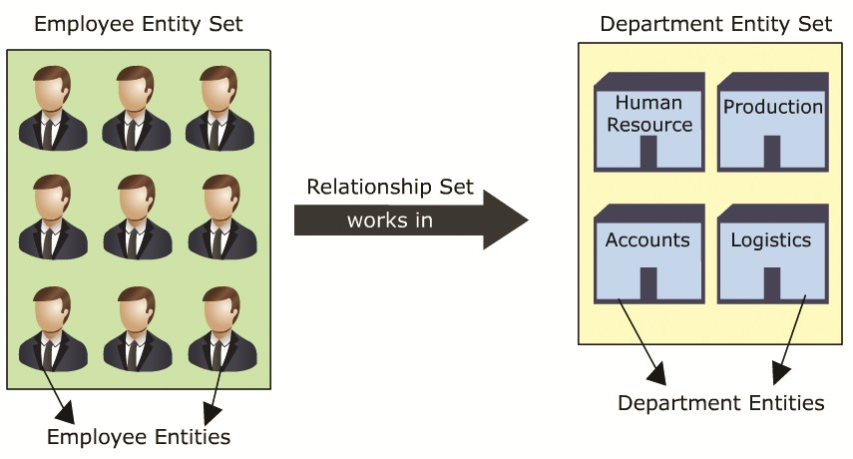

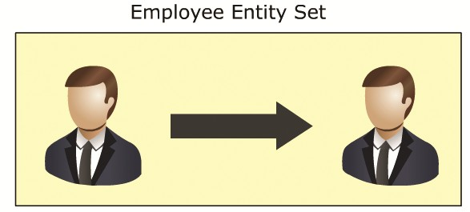
SQL
Server
2012
SQL
Server
2012
The various E-R model components can be seen in the following figure:
Relationships associate one or more entities and can be of three types as follows:
Self-relationships
The relationship can be seen in
following figure:
Relationships between entities of the same entity set are called self-relationships.
For example, a team member works for the
manager.
The relation, 'works for', exists between two different employee entities of the same employee entity set.
8

Slide 9

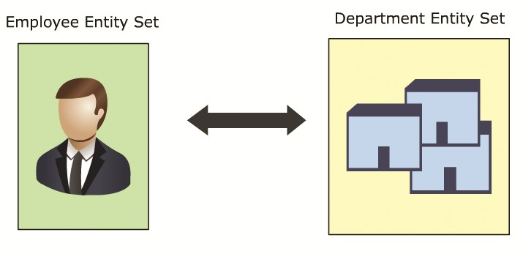
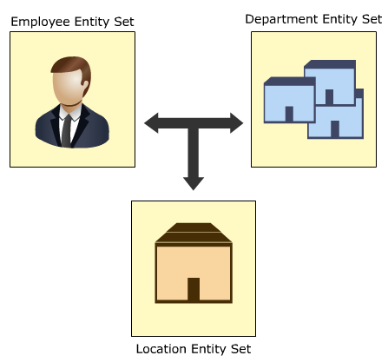
SQL
Server
2012
SQL
Server
2012
Binary Relationships
The relationship can be seen in following figure:
Relationships that exist between entities of two
different entity sets are called binary relationships.
For example, an employee belongs to a department.
The employee entity belongs to an employee entity set. The department entity belongs to a department entity set.
The relationship can be seen in
following figure:
Ternary Relationships
Relationships that exist between three entities of different entity sets are called ternary relationships.
For example, an employee works in the accounts department at the regional branch.
The relation, 'works' exists between all three, the employee, the department, and the location.

Slide 10


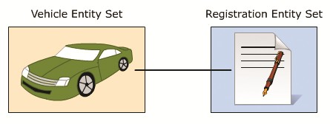
SQL
Server
2012
SQL
Server
2012
Relationships can also be classified as per mapping cardinalities as follows:
This kind of mapping exists when an entity of one entity set can be associated with only one entity of another set.
For example, every vehicle has a unique registration.
No two vehicles can have the same registration details.
The relation is one-to-one, that is, one vehicle-one registration.
The mapping cardinality can be seen in the following figure:

Slide 11

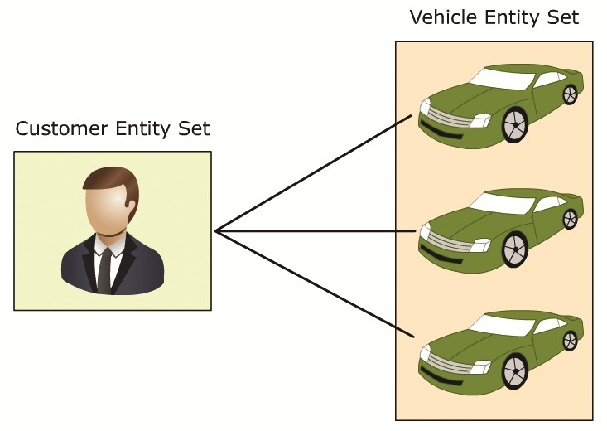
SQL
Server
2012
SQL
Server
2012
This kind of mapping exists when an entity of one set can be associated with more than one entity of another entity set.
For example, a customer can have more than one vehicle.
Therefore, the mapping is a one to many mapping, that is, one customer - one or more vehicles.
The mapping cardinality can be seen in the following figure:

Slide 12
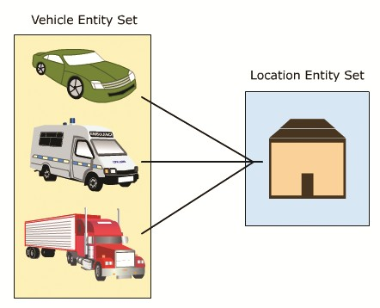
SQL
Server
2012
SQL
Server
2012
This kind of mapping exists when many entities of one set is associated with an entity of another set.
This association is done irrespective of whether the latter entity is already associated to other or more entities of the former entity set.
For example, every vehicle has only one manufacturing company but the same company or coalition can manufacture more than one kind of vehicle.
The mapping can be seen in the following figure:

Slide 13
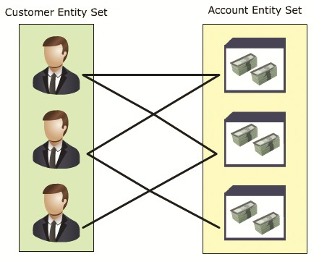
SQL
Server
2012
SQL
Server
2012
This kind of mapping exists when any number of entities of one set can be associated with any number of entities of the other entity set.
For example, customer can have more than one account and an account can have more than one customer associated with it in case it is a joint account or similar.
Therefore, the mapping is many-to-many, that is, one or more customers associated with one or more accounts.
The mapping cardinality can be seen in the following figure:

Slide 14

SQL
Server
2012
Some additional concepts in the E-R model are as follows:
Primary Keys
A primary key is an attribute that can uniquely define an entity in an entity set.
The following table contains the details of students in a school.
SQL
Server
2012
Student Details
Every student has a unique enrollment number (such as enrollment_number), which is unique to the student.
Any student can be identified based on the enrollment number.
Thus, the attribute enrollment_number plays the role of the primary key in the
Student Details table.

Slide 15

SQL
Server
2012
SQL
Server
2012
Weak Entity Sets
Entity sets that do not have enough attributes to establish a primary key are called weak entity sets.
Strong Entity Sets
Entity sets that have enough attributes to establish a primary key are called strong entity sets.
Consider the scenario of an educational institution where at the end of each semester, students are required to complete and submit a set of assignments.
The teacher keeps track of the assignments submitted by the students.
An assignment and a student can be considered as two separate entities.
The assignment entity is described by the attributes assignment_number and
subject.
The student entity is described by roll_number, name, and semester.
The assignment entities can be grouped to form an assignment entity set and the student entities can be grouped to form a student entity set.
The entity sets are associated by the relation 'submitted by'.

Slide 16
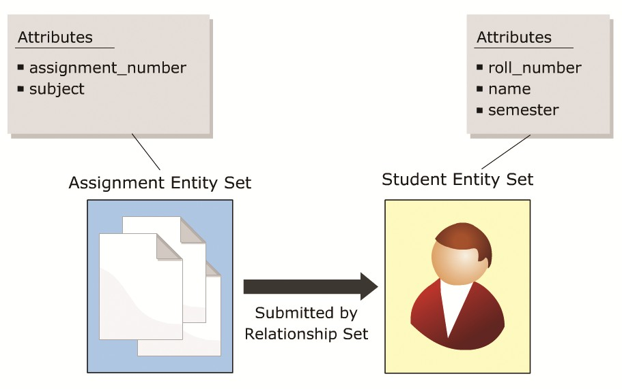
SQL
Server
2012
SQL
Server
2012
The relationship is depicted in the following figure :
The attributes, assignment_number and subject, are not enough to identify an assignment entity uniquely.
The roll_number attribute alone is enough to uniquely identify any student entity.
Therefore, roll_number is a primary key for the student entity set.
The assignment entity set is a weak entity set since it lacks a primary key.
The student entity set is a strong entity set due to the presence of the
roll_number attribute.

Slide 17
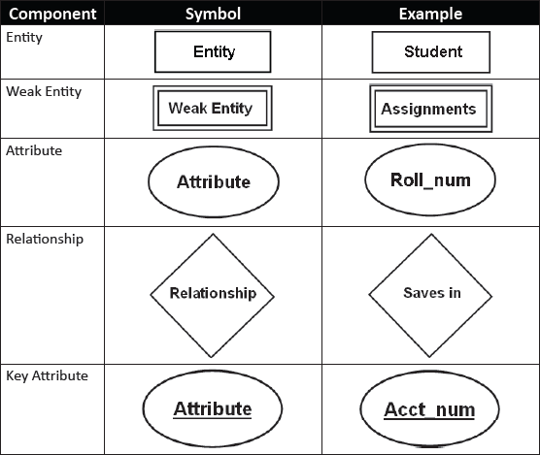
SQL
Server
2012
SQL
Server
2012
The E-R diagram is a graphical representation of the E-R model.
The E-R diagram, with the help of various symbols, effectively represents various
components of the E-R model.
The symbols used for various components can be seen in the following table:

Slide 18


SQL
Server
2012
SQL
Server
2012
Attributes in the E-R model can be further classified as:
A multi-valued attribute is illustrated with a double-line ellipse, which has more than one value for at least one instance of its entity.
This attribute may have upper and lower bounds specified for any individual entity value.
The telephone attribute of an individual may have one or more values, that is, an individual can have one or more telephone numbers.
Hence, the telephone attribute is a multi-valued attribute.
The symbol and example of a multi-valued attribute can be seen in the following figure:

Slide 19
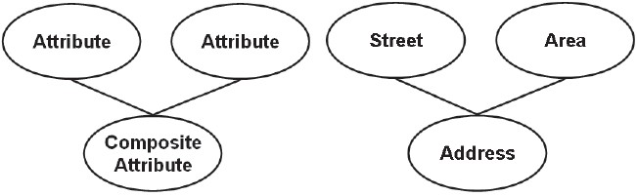
SQL
Server
2012
SQL
Server
2012
A composite attribute may itself contain two or more attributes, which represent basic attributes having independent meanings of their own.
The address attribute is usually a composite attribute, composed of attributes such as street, area, and so on.
The symbol and example of a composite attribute can be seen in the following figure:

Slide 20

SQL
Server
2012
SQL
Server
2012
Derived attributes are attributes whose value is entirely dependent on another attribute and are indicated by dashed ellipses.
The age attribute of a person is the best example for derived attributes.
For a particular person entity, the age of a person can be determined from the current date and the person's birth date.
The symbol and example of a derived attribute can be seen in the following figure:

Slide 21
SQL
Server
2012
SQL
Server
2012
Steps to construct an E-R diagram are as follows:
1
Gather all the data that needs to be modeled.
2
Identify data that can be modeled as real world entities.
3
Identify the attributes for each entity.
Sort entity sets as weak or strong entity sets.
4
Sort entity attributes as key attributes, multi-valued attributes, composite attributes, derived attributes, and so on.
5
Identify the relations between the different entities.
6

Slide 22
SQL
Server
2012
SQL
Server
2012
Consider the scenario of a bank, with customers and accounts. The E-R diagram for the scenario can be constructed as follows:
Step 1: Gather
data
The bank is a collection of accounts used by customers to save money.
Step 2: Identify entities
Customer
Account
Step 3: Identify the attributes
Customer: customer_name, customer_address, customer_contact
Account: account_number, account_owner, balance_amount
Step 4: Sort entity sets
Customer entity set: weak entity set
Account entity set: strong entity set
Step 5: Sort attributes
Customer entity set: customer_address - composite, customer_contact - multi-valued
Account entity set: account_number → primary key, account_owner – multi-valued
Step 6: Identify
relations
A customer 'saves in' an account. The relation is 'saves in'.

Slide 23
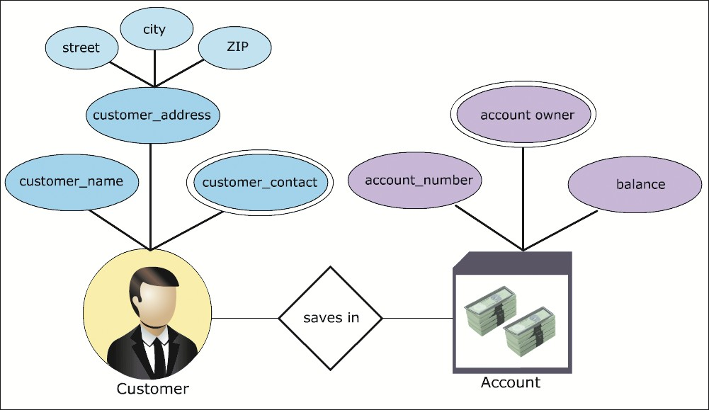
SQL
Server
2012
SQL
Server
2012
Step 7: Draw diagram using symbols
The E-R diagram is shown in the following figure:

Slide 24
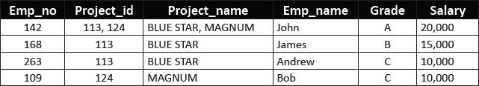

SQL
Server
2012
SQL
Server
2012
Initially, all databases are characterized by large number of columns and records.
This approach has certain drawbacks.
The following table consist of details of the employees and the project they are
working on.
Repetition Anomaly
The data such as Project_id, Project_name, Grade, and Salary repeat many times.
This repetition hampers both, performance during retrieval of data and the storage
capacity.
This repetition of data is called the repetition anomaly.

Slide 25
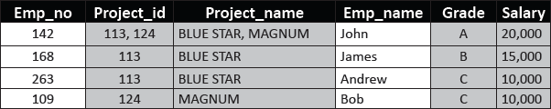
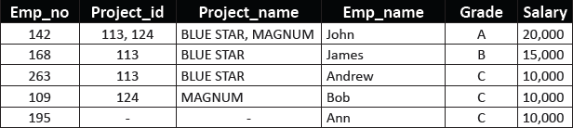
SQL
Server
2012
SQL
Server
2012
The repetition is shown in the following table with the help of shaded cells:
Insertion Anomaly
Suppose the department recruits a new employee named Ann.
Consider that Ann has not been assigned any project. Insertion of her details in the table would leave columns Project_id and Project_name empty.
Leaving columns blank could lead to problems later.
Anomalies created by such insertions are called insertion anomalies as shown in the following table:

Slide 26

SQL
Server
2012
SQL
Server
2012
Deletion Anomaly
Suppose, Bob is relieved from the project MAGNUM.
Deleting the record deletes Bob's Emp_no, Grade, and Salary details too.
This loss of data is harmful as all of Bob's personal details are also lost.
This kind of loss of data due to deletion is called deletion anomaly as can be seen in the following table:
Updating Anomaly
Suppose John was given a hike in Salary or John was demoted.
The change in John's Salary or Grade needs to be reflected in all projects John works for.
This problem in updating all the occurrences is called updating anomaly.

Slide 27
SQL
Server
2012
SQL
Server
2012
The Department Employee Details table is called an unnormalized table.
These drawbacks lead to the need for normalization.
Initially, Codd (1972) presented three normal forms (1NF, 2NF, and 3NF), all based on dependencies among the attributes of a relation.

Slide 28
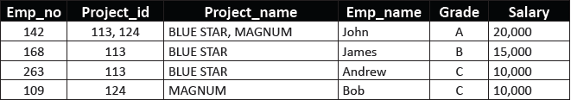
SQL
Server
2012
SQL
Server
2012
In order to achieve the first normal form, following steps need to be performed:
1
Create separate tables for each group of related data.
2
The table columns must have atomic values.
3
All the key attributes must be identified.
Consider the Employee Project Details table as follows:
The table has data related to projects and employees.
The table needs to be split into two tables, that is, a Project Details table and an Employee Details table.
The table columns, Project_id and Project_names, have multiple values.

Slide 29

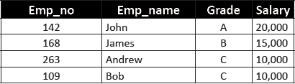
SQL
Server
2012
SQL
Server
2012
The data needs to be split over different rows.
The resultant tables are Project Details and Employee Details as
follows:
Project Details
Employee Details
The Project_id attribute is the primary key for the Project Details table.
The Emp_no attribute is the primary key for the Employee Details table.
Therefore, in first normal form, the initial Employee Project Details table has been reduced to the Project Details and Employee Details tables.

Slide 30
SQL
Server
2012
The tables are said to be in second normal form if:
They meet the requirements of the first normal form.
There are no partial dependencies in the tables. The tables are related through foreign keys.
SQL
Server
2012
Partial dependency means a non-key attribute should not be partially dependent on more than one key attribute.
The Project Details and Employee Details tables do not exhibit any
partial dependencies.
The Project_name is dependent only on Project_id and Emp_name, Grade, and Salary are dependant only on Emp_no.
The tables also need to be related through foreign keys.
A third table, named Employee Project Details, is created with only two columns, Project_id and Emp_no.

Slide 31

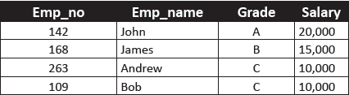
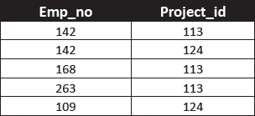
SQL
Server
2012
SQL
Server
2012
So, the project and employee details tables on conversion to second normal form generates tables Project Details, Employee Details, and Employee Project Details as follows:
Project Details
Employee Details
Employee Project Details
The attributes, Emp_no and Project_id, of the Employee Project Details table combine together to form the primary key.
➢
Such primary keys are called composite primary keys.

Slide 32
SQL
Server
2012
To achieve the third normal form:
The tables should meet the requirements of the second normal form
The tables should not have transitive dependencies in them
SQL
Server
2012
The Project Details, Employee Details, and Employee Project Details tables are in second normal form.
If an attribute can be determined by another non-key attribute, it is called a transitive dependency.
That is, every non-key attribute should be determined by the key attribute only.
If a non-key attribute can be determined by another non-key attribute, it needs to
put into another table.
32

Slide 33
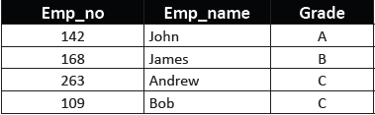

SQL
Server
2012
SQL
Server
2012
On observing the different tables, it is seen that the Project Details and Employee Project Details tables do not exhibit any such transitive dependencies.
The non-key attributes are totally determined by the key attributes.
Project_name is only determined by Project_number.
On further scrutinizing the Employee Details table, a certain inconsistency is seen.
The attribute Salary is determined by the attribute Grade and not the key
attribute Emp_no.
Thus, this transitive dependency needs to be removed.
The Employee Details table can be split into Employee Details and
Grade Salary Details tables as follows:
Employee Details
Grade Salary Details

Slide 34
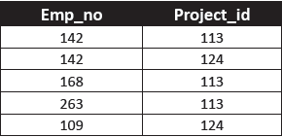

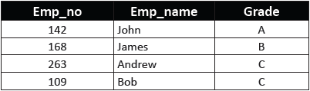

SQL
Server
2012
SQL
Server
2012
Thus, at the end of the three normalization stages, the initial Employee Project Details table has been reduced to the Project Details, Employee Project Details, Employee Details, and Grade Salary Details tables as follows:
Project Details
Employee Project Details
Employee Details
Grade Salary Details

Slide 35
SQL
Server
2012
SQL
Server
2012
By normalizing a database, redundancy is reduced.
However, it has following drawbacks:
Complex join queries may have to be written often to combine the data in
multiple tables.
Joins may practically involve more than three tables depending on the need for information.
If such joins are used very often, the performance of the database will become very poor.
In such cases, storing a few fields redundantly can be ignored to increase the performance of the database.
The databases that possess such minor redundancies in order to increase performance are called denormalized databases and the process of doing so is called denormalization.

Slide 36

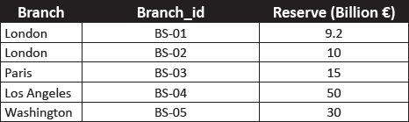
SQL
Server
2012
The relational model is based on the solid foundation of Relational Algebra.
Relational Algebra consists of a collection of operators that operate on relations.
Each operator takes one or two relations as its input and produces a new relation as its output.
Consider the Branch Reserve Details as shown in the following table.
SQL
Server
2012
Branch Reserve Details

Slide 37



SQL
Server
2012
SQL
Server
2012
The SELECT operator is used to extract data that satisfies a given condition.
The lowercase Greek letter sigma, 'σ', is used to denote selection.
A select operation, on the Branch Reserve Details table, to display the
details of the branches in London would result in the following table:
Details of Branches in London
A selection on the Branch Reserve Details table to display branches with reserve greater than 20 billion Euros would result in the following table:
Details of Branches with Reserves Greater than 20 Billion Euros

Slide 38

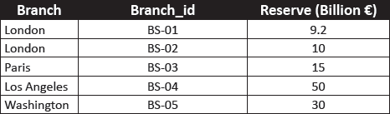
SQL
Server
2012
SQL
Server
2012
The PROJECT operator is used to project certain details of a relational table.
The PROJECT operator only displays the required details leaving out certain
columns.
The PROJECT operator is denoted by the Greek letter pi, ‘E'.
Assume that only the Branch_id and Reserve amounts need to be displayed.
A project operation to do the same, on the Branch Reserve Details table, would result in the following table:
Resultant Table With Branch_id And Reserve Amounts

Slide 39


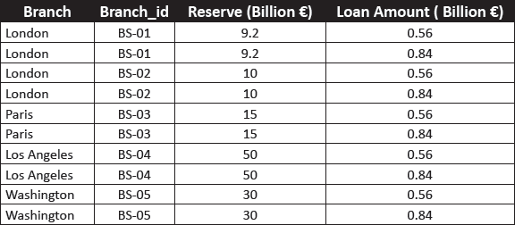
SQL
Server
2012
SQL
Server
2012
The PRODUCT operator, denoted by 'x‘ combines each record from the first table with all the records in the second table, thereby, generating all possible combinations between the table records. Consider the following table:
Branch Loan Details
The product operation on the Branch Reserve Details and Branch Loan Details tables would result in the following table:
Product of Branch Reserve Details and Branch Loan Details

Slide 40


SQL
Server
2012
SQL
Server
2012
Suppose an official of the bank with the data given in tables Branch Reserve Details and Branch Loan Details wanted to know which branches had reserves below 20 billion Euros or loans.
The resultant table would consist of branches with either reserves below 20 billion Euros or loans or both.
This is similar to the union of two sets of data; first, set of branches with reserve less than 20 billion Euros and second, branches with loans.
Branches with both, reserves below 20 billion Euros and loans would be displayed only once.
The UNION operator does just that, it collects the data from the different tables and
presents a unified version of the complete data.
The union operation is represented by the symbol, 'U'.
The union of the Branch Reserve Details and Branch Loan Details
tables would generate the following table:
Unified Representation of Branches with Less Reserves or Loans

Slide 41


SQL
Server
2012
SQL
Server
2012
Suppose the same official after seeing this data wanted to know which of these branches had both low reserves and loans too.
The answer would be the intersect relational operation.
The INTERSECT operator generates data that holds true in all the tables it is
applied on.
It is based on the intersection set theory and is represented by the '∩' symbol.
The result of the intersection of the Branch Reserve Details and Branch Loan Details tables would be a list of branches that have both reserves below
20 billion Euros and loans in their account.
The resultant table generated is as follows:
Branches with Low Reserves and Loans

Slide 42


SQL
Server
2012
SQL
Server
2012
If the same official now wanted the list of branches that had low reserves but no loans, then the official would have to use the difference operation.
The DIFFERENCE operator, symbolized as '-', generates data from different tables too, but it generates data that holds true in one table and not the other.
Thus, the branch would have to have low reserves and no loans to be displayed.
Following table is the result generated:
Branches with Low Reserves but No Loans

Slide 43


SQL
Server
2012
The JOIN operation is an enhancement to the product operation.
It allows a selection to be performed on the product of tables.
For example, if the reserve values and loan amounts of branches with low reserves and loan values was needed, the product of the Branch Reserve Details and Branch Loan Details would be required.
Once the product of the two tables would be generated, only those branches would be listed which have both reserves below 20 billion Euros and loans.
Following table is generated as a result of the JOIN operation:
SQL
Server
2012
Detailed List of Branches with Low Reserve and Loans

Slide 44


SQL
Server
2012
SQL
Server
2012
Suppose an official wanted to see the branch names and reserves of all the branches that had loans.
This process can be made very easy by using the DIVIDE operator.
All that the official needs to do is divide the Branch Reserve Details table by the list of branches, that is, the Branch_Id column of the Branch Loan Details table.
Following table is the result generated.
Resultant Table of Division Operation
The attributes of the divisor table should always be a subset of the dividend table.
The resultant table would always be void of the attributes of the divisor table, and the records not matching the records in the divisor table.

Slide 45

SQL
Server
2012
Data modeling is the process of applying an appropriate data model to the data at hand.
E-R model views the real world as a set of basic objects and relationships among them.
Entity, attributes, entity set, relationships, and relationship sets form the five basic
components of E-R model.
Mapping cardinalities express the number of entities that an entity is associated with.
The process of removing redundant data from the tables of a relational database is called normalization.
Relational Algebra consists of a collection of operators that help retrieve data from the relational databases.
SELECT, PRODUCT, UNION, and DIVIDE are some of the relational algebra
SQL
Server
2012
operators.

